Slide 1

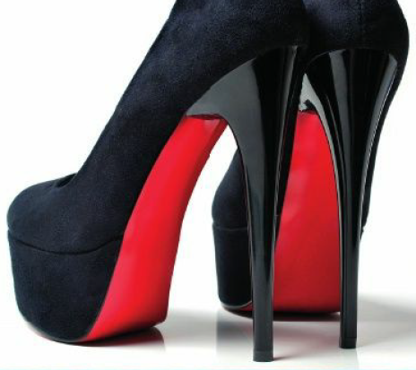
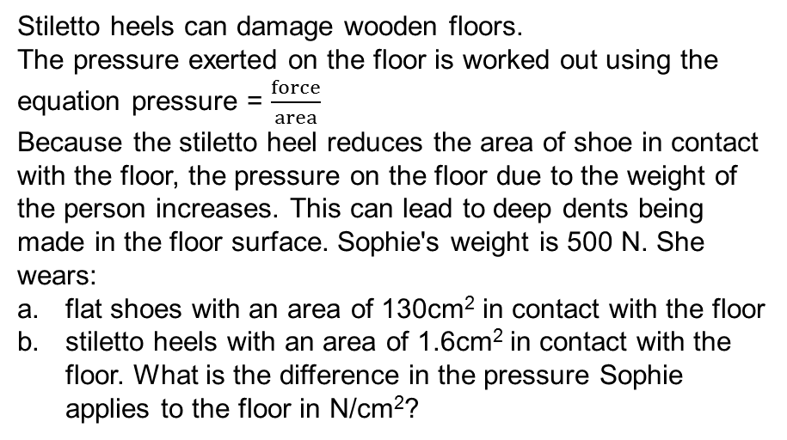
Mathematics (9-1) - iGCSE
2018-20
Year 09
Stiletto heels can damage wooden floors.
The pressure exerted on the floor is worked out using the equation pressure = $\frac{force}{area}$
Because the stiletto heel reduces the area of shoe in contact with the floor, the pressure on the floor due to the weight of the person increases. This can lead to deep dents being made in the floor surface. Sophie's weight is 500 N. She wears:
flat shoes with an area of 130cm² in contact with the floor
stiletto heels with an area of 1.6cm² in contact with the floor. What is the difference in the pressure Sophie applies to the floor in N/cm²?
Unit 11 – Multiplicative Reasoning

Slide 2
Contents
Page iv
11 Multiplicative reasoning 339
Prior knowledge check 339
11.1 Growth and decay 340
11.2 Compound measures 343
11.3 More compound measures 346
11.4 Ratio and proportion 348
Problem-solving 351
Check up 352
Strengthen 354
Extend 357
Knowledge check 359
Unit test 360

Slide 3
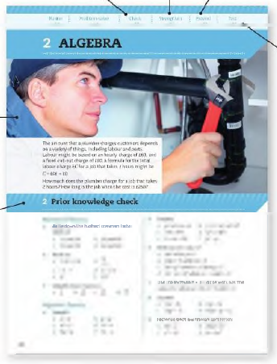
Contents
Page v
At the end of the Master lessons, take a check-up test to help you to decide whether to strengthen or Extend our learning
Extend helps you to apply the maths you know to some different situations
Unit Openers put the maths you are about to learn into a real-life context. Have a go at the question - it uses maths you have already learnt so you should be able to answer it at the start of the unit.
When you have finished the whole unit, a Unit test helps you see how much progress you are making.
Choose only the topics in strengthen thay you need a bit more practice with. You’ll find more hints here to lead you through specific questions. Then move on to Extend
Use the Prior knowledge check to make sure you are ready to start the main lessons in the unit. It checks your knowledge from Key Stage 3 and from earlier in the GCSE course. Your teacher has access to worksheets if you need to recap anything.

Slide 4
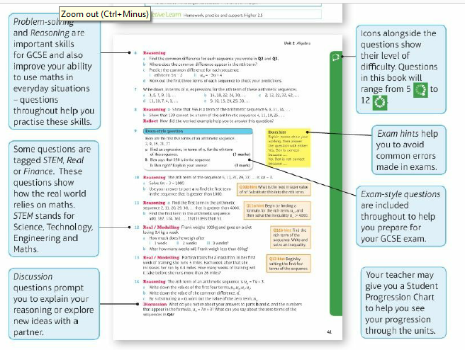
Contents
Page vi

Slide 5
11 – Prior Knowledge Check
Page 339
Numerical fluency
3 metres of material cost £1.56
Work out the cost of 5 metres of the same material.
Connor is paid £54 for 8 hours work in a supermarket.
How much is he paid for 10 hours work?
An orchestra of 10 people takes 5 minutes to play a song.
How long will it take 20 people?

Slide 6
11 – Prior Knowledge Check
Page 339
Numerical fluency
A recipe for 6 people uses 750g of mince. How much mince is needed for 16 people?
Milk is sold in two sizes of bottle.
A 4-pint bottle of milk costs £0.98.
A 6-pint bottle of milk costs £1.44.
Which bottle of milk is the best value for money?
Show all your working.
3 men build a wall in 2 days. How long will it take
  1 man b. 2 men?

Slide 7
11 – Prior Knowledge Check
Page 339
Fluency with measures
The ratio 1m: 1cm = 100:1.
Copy and complete.
  1 kg : 1 g =□ : □
  1cm : 1mm = □ : □
  1 litre: 1 ml = □ : □
  1 minute: 1 second = □ : □
  1 hour : 1 minute = □ : □
Copy and complete,
  180 cm = □ m
  28 000 cm = □ m
  54 600 m = □ km

Slide 8
11 – Prior Knowledge Check
Page 339
Fluency with measures
The ratio 1m: 1cm = 100:1.
Copy and complete.
  1 kg : 1 g =□ : □
  1cm : 1mm = □ : □
  1 litre: 1 ml = □ : □
  1 minute: 1 second = □ : □
  1 hour : 1 minute = □ : □
Copy and complete,
  180 cm = □ m
  28 000 cm = □ m
  54 600 m = □ km

Slide 9
11 – Prior Knowledge Check
Page 339
Fluency with measures
12 inches = 1 foot, 3 feet =1 yard. Use this to work out
  4 feet in inches
  5 yards in feet
  58 inches in feet and inches.
20 fluid ounces = 1 pint, 8 pints = 1 gallon. Use this to work out
  4 pints in fluid ounces
  5 gallons in pints
  20 pints in gallons and pints.
5 miles = 8 km. Use this to work out
  40 miles in km
  48 km in miles.

Slide 10
11 – Prior Knowledge Check
Page 340
Fluency with measures
Copy and complete.
  1½ hours = □ minutes
  50 minutes = □ seconds
  225 minutes = □ hours □ minutes
Jess goes on holiday to New York. The exchange rate of £:US dollars is 1:1.613.
  She changes £500 into US dollars. How many US dollars should she get?
  After her holiday, Jess changes 80 dollars back into pounds.
  The exchange rate is the same.
  How much money should she get?
  Give your answer to the nearest penny.

Slide 11
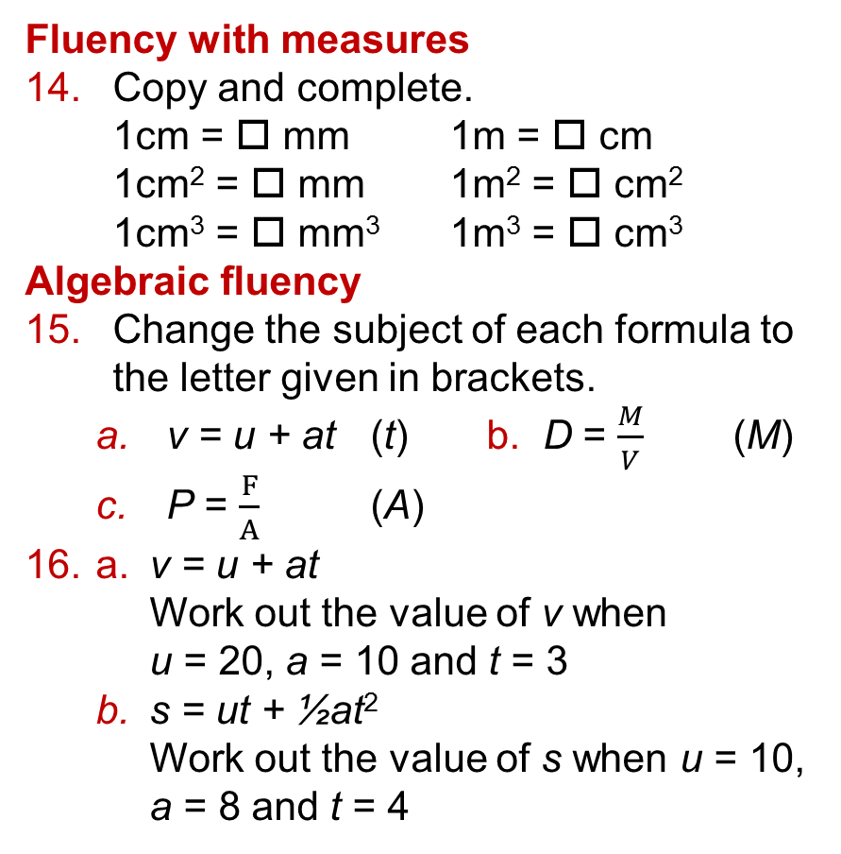
11 – Prior Knowledge Check
Page 340
Fluency with measures
Copy and complete.
  1cm = □ mm 1m = □ cm
  1cm² = □ mm 1m² = □ cm²
  1cm³ = □ mm³ 1m³ = □ cm³
Algebraic fluency
Change the subject of each formula to the letter given in brackets.
  v = u + at (t) b. D = $\frac{M}{V}$ (M)
  P = $\frac{F}{A}$ (A)
a. v = u + at
Work out the value of v when
u = 20, a = 10 and t = 3
  s = ut + ½at²
  Work out the value of s when u = 10, a = 8 and t = 4

Slide 12
11 – Prior Knowledge Check
Page 340
* Challenge
Do you know on which day of the week you were born?
You can use Zeller's algorithm to work it out from your date of birth.
An algorithm is a sequence of precise instructions to solve a problem.
Example 15 May 1999
Let: day number = D D = 15
month number = M M = 5
and year = Y Y = 1999
When M is 1 or2 add 12 to M M = 5 (no change)
and subtract 1 from Y Y = 1999 (no change)
Let C be the first two digits of Y C = 19
and Y‘ be the last two digits of Y Y = 99
Add together the integer parts of:
(2.6 x M - 5.39), (Y’ ÷ 4) and (C ÷ 4), 7 + 24 + 4
then add on D and Y' and subtract 2C. +15 + 99-38 = 111
Find the remainder when this quantity is 111 + 7 = 15 remainder 6
divided by 7. When the remainder is 0 Sun, 15 May 1999 was a Saturday
1 Mon, 2 Tue,...
Q17 hint - The integer part of a number is the whole-number part, e.g. the integer part of 19.75 is 19

Slide 13
11.1 – Growth and Decay
Page 340
Objectives |  | Why Learn This?
Find an amount after repeated percentage changes. Solve growth and decay problems. |  | Repeated proportional change can be used to predict changes in population size over short periods of time.
Fluency
Work out: 4 x 4 x 4 x 4 = 4□ b. 3 x 3 x 3 x 3 x 3 = 3□
ActiveLearn - Homework, practice and support: Higher 11.1

Slide 14
11.1 – Growth and Decay
Page 341
Work out the multiplier as a decimal for
  an increase of 30%
  a decrease of 14%
  an increase of 7.2%
  a decrease of 2.5%.
Warm Up
Q1a hint – 100% + 30% = 130%
130% = □ as a decimal number.
Q1b hint – 100% - 14% = □%
□% = □ as a decimal number.
Questions in this unit are targeted at the steps indicated.

Slide 15

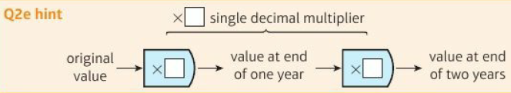
11.1 – Growth and Decay
Page 341
Real Wes bought a car for £6500. It lost 35% of its value in the
first year. It lost 15% of its value in the second year. Work out
  the multiplier to find the value of the car at the end of the first year
  the value of the car at the end of the first year
  the multiplier to find the value of the car at the end of the second year
  the value of the car at the end of the second year
  the decimal multiplier that the original value of the car can be multiplied by to find its value at the end of two years.
  Discussion What do you notice about your answers to parts a, c and e?
  What is a quick way to find the answer to part d, without steps a to e?
Q2a hint – Decrease by 35%
Q2c hint – Decrease by □%

Slide 16
11.1 – Growth and Decay
Page 341
Work out the decimal multiplier that represents:
  an increase of 12% for 3 years
  decrease of 15% for 4 years.
Discussion How could you write these multipliers as a power rather than a decimal number?
Reasoning Becky says an increase of 15% followed by an increase of 22% is the same as an increase of 37%. Is Becky correct? Explain.
Q3a hint – x 12□
Q5 hint - Show your working. Write a sentence to explain.

Slide 17
11.1 – Growth and Decay
Page 341
Finance Abdul has a job with an annual salary of £35000. At the end of the first year he is given an increase of 2%. At the end of the second year he is given an increase of 3.5%. Work out Abdul's salary at the end of two years.
Q4 hint - Work out the decimal multiplier that the original salary can be multiplied by to find the salary at the end of two years.
Q4 communication hint - Annual means ‘yearly'.

Slide 18
11.1 – Growth and Decay
Page 341
Work out the multiplier as a decimal number for
  an increase of 5% followed by an increase of 3%
  a decrease of 20% followed by a decrease of 15%
  an increase of 9% followed by a decrease of 6%.
Finance Tristan buys a flat for £35000. In the first year, the value of the flat increases by 12%. In the second year, the value of the flat decreases by 3%.
Work out the value of the flat after the 2 years.

Slide 19
11.1 – Growth and Decay
Page 342
Abi buys a motor bike for £8200. In the first year the motorbike depreciates by 25%. In the second year it depreciates by 12%. What is the value of the motorbike at the end of the two years?
Finance / Reasoning £3500 is invested for 2 years at 4.1% per annum compound interest. Work out the total amount in the account after 2 years.
Q8 communication hint - To depreciate means to decrease in value.

Slide 20
11.1 – Growth and Decay
Page 342
Finance £2500 is invested for 2 years at 4.3% per annum compound interest. Work out the total amount in the account after 2 years.
Q9 hint - Multiplier = □
Amount in account after 2 years =
2000 x □ x □
Q9 communication hint - In compound interest the interest earned each year is added to money in the account and earns interest the next year. Most interest rates are compound interest rates.

Slide 21
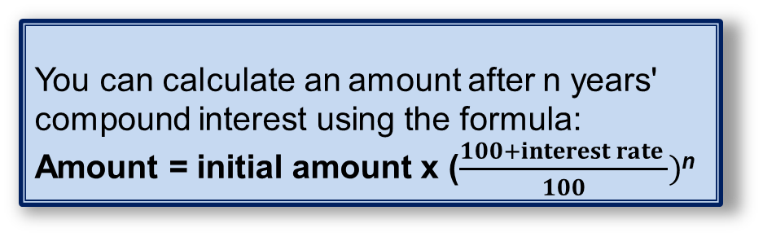
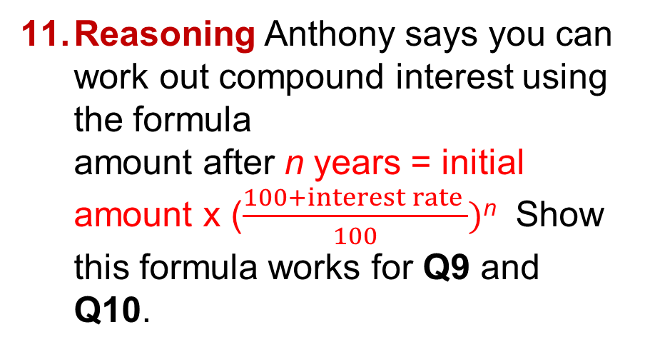
11.1 – Growth and Decay
Page 342
Reasoning Anthony says you can work out compound interest using the formula
amount after n years = initial amount x ($\frac{100+interest rate }{100})$^{n} Show this formula works for Q9 and Q10.
Q11 hint – Do you get the same answers if you use the formula for Q9 and Q10?
Key Point 1
You can calculate an amount after n years' compound interest using the formula:
Amount = initial amount x ($\frac{100+interest rate }{100})$^{n}

Slide 22
11.1 – Growth and Decay
Page 342
Finance £3000 is invested for 2 years at 3.8% per annum compound interest.
Work out the total interest earned over the 2 years.
Q12 hint – Total interest = amount in the account at the end of the investment - amount invested

Slide 23
11.1 – Growth and Decay
Page 342
Example 1
Paul invests £4500 in an account for 2 years. The account pays 3.2% compound interest per annum. Paul has to pay 20% tax on the interest earned each year. The tax is taken from the account at the end of each year.
Paul thinks that at the end of the 2 years he will have
at least £4700 in this account.
Is Paul correct? Show all your working.
Year1
Interest = 0.032 x 4500 = £144
Tax - 0.2 x 144 - £26.60
Amount in account at end of year 1 = 4500 + 144 - 28.60
= £4615.20
Year 2
Start with £4615.20
Interest = 0.032 x 4615.20 = £ 147.69
Tax = 0.2 x 147.69 = £29.54
Amount in account at end of year 1 =4615.20 + 147.69-29.54
= £4733.35
Paul is correct. £4733.35 is more than £4700.
3.2% = 0.032
Amount in account at end of year 1: £4500 + interest- 20% of interest
Amount in account at end
of year 2: £4615.20 + interest- 20% of interest

Slide 24

11.1 – Growth and Decay
Page 343
13 – Exam-Style Questions
Katie invests £200 in a savings account for 2 years.
The account pays compound interest at an annual rate of 3.3% for the first year 1.5% for the second year.
Work out the total amount of money in Katie's account at the end of 2 years. (3 marks)
Katie travels to work by train.
The cost of her weekly train ticket increases by 12.5% to £225 Katie's weekly pay increases by 5% to £535.50
Compare the increase in the amount of money Katie has to pay for her weekly train ticket with the increase in her weekly pay.
(3 marks) June 2014, QI8,1MA0/2H
Exam hint
Make sure you show all your working clearly when doing the comparison.
Q13a strategy hint - What is the multiplier for the 2 years?

Slide 25
11.1 – Growth and Decay
Page 343
Problem-solving / Finance Laura invests £3600 in a savings account for 2 years. The account pays 3.52% compound interest per annum. Laura has to pay 40% tax on the interest earned each year. The tax is taken from the account at the end of each year.
How much is in the account at the end of 2 years?
Reasoning / Finance Fidel invested £4200 in a savings account. He is paid 3.25% per annum compound interest.
How many years before he has £4928.33 in the savings account?
Q15 strategy hint - Try different values of it in the formula.

Slide 26
11.1 – Growth and Decay
Page 343
STEM The level of activity of a radioactive source decreases by 5% per hour.
The activity is 1400 counts per second at one point,
  What will it be 2 hours later?
  After how many complete hours will the count be less than 500 counts per second?
Real In 2014 a fast-food chain has 180 outlets in the UK. The number of outlets is increasing at a rate of 9% each year,
  How many outlets will it have in 2020?
  Reflect What is an appropriate degree of accuracy to give for this question? Why?

Slide 27
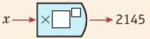
11.1 – Growth and Decay
Page 343
A population of insects increases by 25% per day.
At the end of one week there are 2145 insects.
How many insects were there at the beginning of the week?
Q18 hint – Use x for the number of insects at the beginning of the week.

Slide 28
11.2 – Compound Measures
Page 343
Objectives |  | Why Learn This?
Calculate rates. Convert between metric speed measures. Use a formula to calculate speed and acceleration. |  | Police Accident Investigation Teams use kinematics formulae to work out the speed of cars involved in serious accidents.
Fluency
Find the rates for: £60 fora 6-hour day £□ per hour 300 km on 20 litres of petrol □km per □
ActiveLearn - Homework, practice and support: Higher 11.2

Slide 29
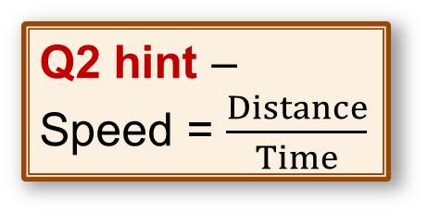
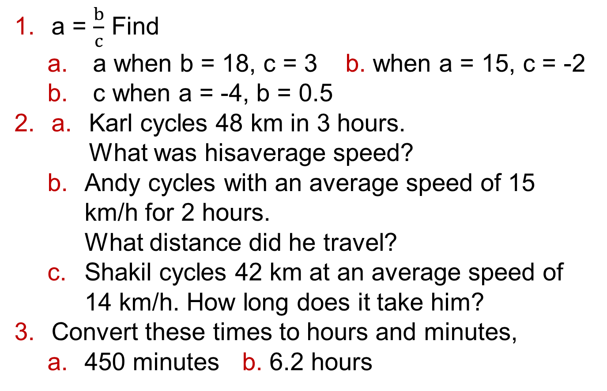
11.2 – Compound Measures
Page 344
a = $\frac{b}{c}$ Find
  a when b = 18, c = 3 b. when a = 15, c = -2
  c when a = -4, b = 0.5
a. Karl cycles 48 km in 3 hours.
What was hisaverage speed?
  Andy cycles with an average speed of 15 km/h for 2 hours.
  What distance did he travel?
  Shakil cycles 42 km at an average speed of 14 km/h. How long does it take him?
Convert these times to hours and minutes,
  450 minutes b. 6.2 hours
Warm Up
Q2 hint –
Speed = $\frac{Distance}{Time}$

Slide 30

11.2 – Compound Measures
Page 344
Problem-solving / Finance George works a 35-hour week and some overtime.
He is paid £8.50 an hour for this work. George is paid time and a half for each hour he works on a Saturday and double time for each hour he works on a Sunday,
  How much is George paid for a week when he works a 35-hour week, plus 4 hours on Saturday and 3 hours on Sunday?
  In one week George works a 35-hour week and some hours on Saturday. He is paid £335.75 for the week. How many hours did George work on Saturday?
Q4b hint – How much more is George paid than for his 35-hour week?
Q4a hint – Rate of pay for Saturday = 1.5 x □ = □ Rate of pay for Sunday =2 x □ = □

Slide 31
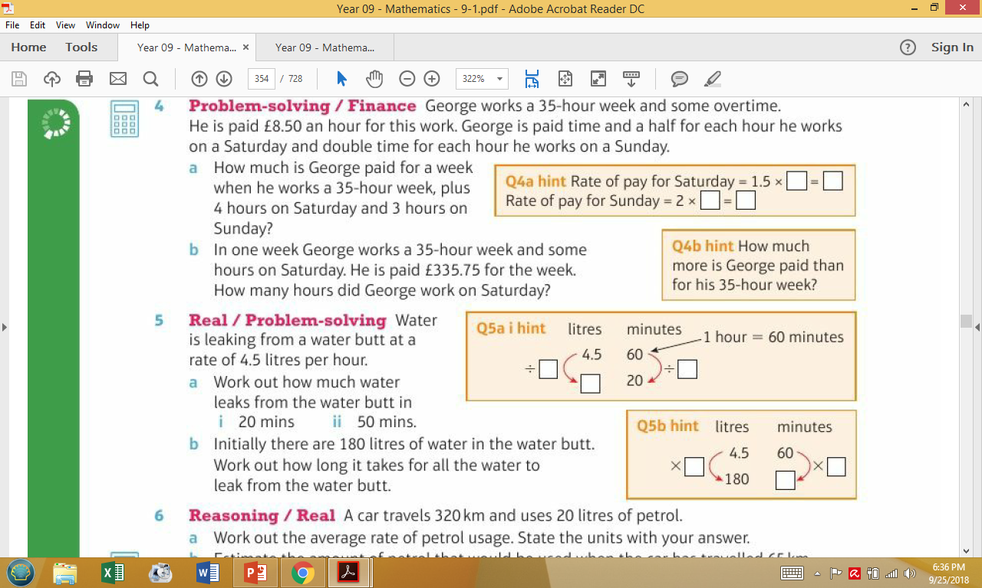
11.2 – Compound Measures
Page 344
Real / Problem-solving Water is leaking from a water butt at a rate of 4.5 litres per hour,
  Work out how much water leaks from the water butt in
    20 mins ii. 50 mins.
  Initially there are 180 litres of water in the water butt Work out how long it takes for all the water to leak from the water butt.
Q5a hint – litres minutes
1 hour = 60 minutes
Q5b hint – litres minutes

Slide 32
11.2 – Compound Measures
Page 344
Reasoning / Real A car travels 320 km and uses 20 litres of petrol,
  Work out the average rate of petrol usage. State the units with your answer,
  Estimate the amount of petrol that would be used when the car has travelled 65 km.
  Discussion Why does the question ask for 'average rate' rather than 'exact rate’?

Slide 33
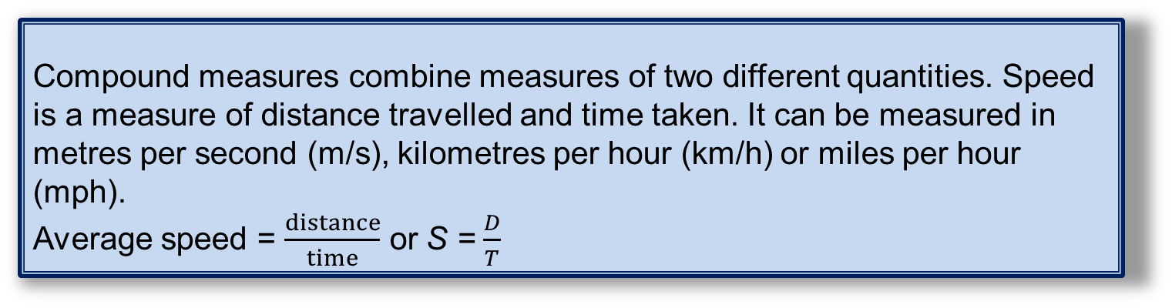
11.2 – Compound Measures
Page 344
Key Point 2
Compound measures combine measures of two different quantities. Speed is a measure of distance travelled and time taken. It can be measured in metres per second (m/s), kilometres per hour (km/h) or miles per hour (mph).
Average speed = $\frac{distance}{time}$ or S = $\frac{D}{T}$
Example 1
A man walks at an average speed of 5.4 km/h. What is his average speed in m/s?
5.4km/h
5400m/h
90m/min
1.5 m/s
Convert to km/h to m/h x 1000
Convert m/h to m/min + 60
Convert m/min to m/s + 60

Slide 34

11.2 – Compound Measures
Page 344
Convert these speeds from m/h to km/h.
  650 m/h b. 7800 m/h
  256 000 m/h d. 188 000 m/h
Reasoning Convert these speeds from metres per second (m/s) to metres per hour (m/h).
  1m/s b. 12m/s
  8m/s d. 4.5m/s
  Would more or less metres be travelled in 1 hour than in 1 second?
Q8 hint –
metres per second
metres per minute
metres per hour
x □
x □

Slide 35
11.2 – Compound Measures
Page 345
Copy and complete the table.
Real A commercial aeroplane has a cruising speed of 250 m/s.
What is this speed in km/h?
Problem-solving / Reasoning A Formula 1 racing car has a top speed of 350km/h. A peregrine falcon is the fastest bird with a speed of 108 m/s.
Which is fastest? Explain your answer.
Metres per second | Kilometres per second
 | 54
 | 72
30
45

Slide 36
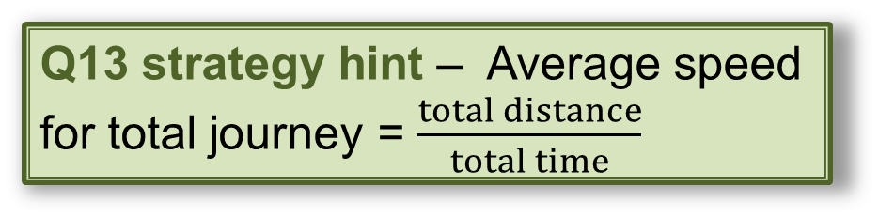
11.2 – Compound Measures
Page 345
a. A car travels at x km/h. Write an expression for this speed in m/s.
  A cheetah runs at y m/s. Write an expression for this speed in km/h.
13 – Exam-Style Questions
Karl travels 35 miles in 45 minutes then 65 km in 1½ hours.
5 miles = 8 kilometres
What is his average speed for the total journey in km/h? (3 marks)
Q13 strategy hint – Average speed for total journey = $\frac{total distance}{total time}$

Slide 37
11.2 – Compound Measures
Page 345
STEM A swallow flies for 40 minutes at an average speed of 11 m/s. How far does the swallow fly in kilometres?
Paul swims 750 metres in 25 minutes. What is his average speed in km/h?
Q15 strategy hint – First convert 750 m to km and 25 minutes to hours but leave each as a fraction before finding the average speed in km/h.

Slide 38
11.2 – Compound Measures
Page 345
Key Point 3
These are kinematics formulae:
v = u + at
s = ut + ½at²
v² = u² + 2as
where a is constant acceleration, u is initial velocity, v is final velocity, s is displacement from the position when t = 0 and t is time taken.
In exam questions you will need to decide which equation to use.
Velocity is speed in a given direction, possible units are m/s.
Initial velocity is speed in a given direction at the start of the motion.
Acceleration is the rate of change of velocity, i.e. a measure of how the velocity changes with time, possible units are m/s².

Slide 39
11.2 – Compound Measures
Page 345
STEM A car starts from rest and accelerates at 5 m/s2 for 200 m.
Work out the final velocity in m/s.
STEM A tram has an initial velocity of 300m/minute. It travels a distance of 0.5km in 20 seconds. What is the acceleration of the tram in m/s²?
STEM A bus travels with an acceleration of 2 m/s² and reaches a speed of 45 km/h in 5 seconds. What was the initial velocity of the bus in m/s?
Q16 strategy hint – When the car starts from rest the initial velocity u = 0. You are given a = 5, s = 200 and want to find v. Use the equation that contains u, a, s and v but not t.

Slide 40
11.3 – More Compound Measures
Page 346
Objectives |  | Why Learn This?
Solve problems involving compound measures. |  | Pressure and density are both examples of measures. Water pressure increases with depth and so is an important factor to consider in scuba diving.
Fluency
□cm² = 1m² □cm³ = 1m³ What is the formula for the area of a circle? What is the formula for the volume of a prism?
ActiveLearn - Homework, practice and support: Higher 11.3

Slide 41
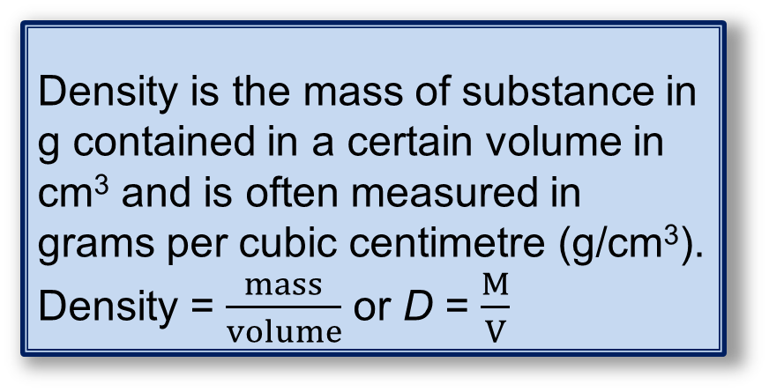
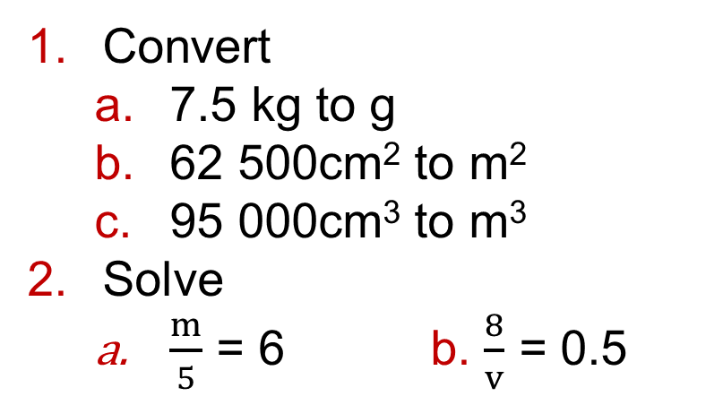
11.3 – More Compound Measures
Page 346
Convert
  7.5 kg to g
  62 500cm² to m²
  95 000cm³ to m³
Solve
  $\frac{m}{5}$ = 6 b. $\frac{8}{v}$ = 0.5
Warm Up
Key Point 4
Density is the mass of substance in g contained in a certain volume in cm³ and is often measured in grams per cubic centimetre (g/cm³).
Density = $\frac{mass}{volume}$ or D = $\frac{M}{V}$

Slide 42
11.3 – More Compound Measures
Page 346
Real A sample of brass has a mass of 2 kg and a volume of 240 cm³. What is its density in g/cm³?
A cubic metre of concrete has a mass of 2400 kg.
What is the density of the concrete in g/cm³?
Q3 hint – First convert mass to g.
Q4 hint – 1m³ = □cm³.

Slide 43
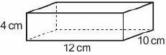

11.3 – More Compound Measures
Page 346
Example 3
The diagram shows a block of
wood in the shape of a cuboid.
The density of wood is 0.6 g/cm³.
Work out the mass of the
block of wood.
Density = $\frac{mass}{volume}$
Volume of block = l x w x h
= 12 x 10 x 4 = 480cm³
0.6 = $\frac{mass}{480}$
0.6 x 480 = $\frac{mass}{480}$ x 48O
Mass = 288g
First write down the formula you are going to use.
You are given the density and are asked for the mass. So work out the volume in cm³.
Substitute values into the formula
Multiply both sides by 480.

Slide 44
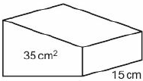
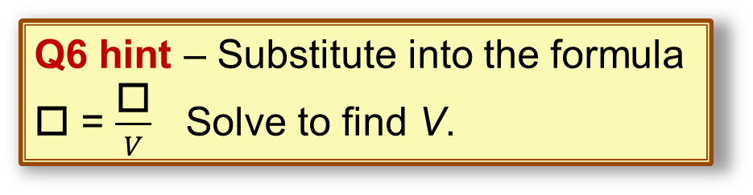
11.3 – More Compound Measures
Page 347
STEM The area of the cross-section of a plastic prism is 35cm². Its length is 15cm.
The plastic has a density of 3.9 g/cm³. What is
the mass of the
prism?
STEM Iron has density 8 g/cm³.
The mass of a piece of iron is 5.4 kg. What is the volume?
Q6 hint – Substitute into the formula □ = $\frac{\text{□}}{V}$ Solve to find V.

Slide 45
11.3 – More Compound Measures
Page 347
STEM The density of copper is 8940 kg/m³. What is the density of copper in g/m³?
STEM The density of aluminium is 2.70 g/cm³. What is the density of aluminium in kg/m³?
Q7 hint – 8940 kg/m³
□ g/m³
x □
Q8 hint –
2.70 g/cm³
Convert to kg □
Convert to kg □
kg/cm³
Kg/m³

Slide 46
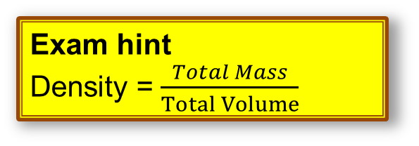
11.3 – More Compound Measures
Page 347
A metal has density kg/cm³.
Write an expression for its density in kg/m³.
STEM / Reasoning 1 cm³ of gold has mass 19.32 g.
1 cm³ of platinum has mass 21.45 g.
Which metal is denser? Explain.
11 – Exam-Style Questions
The density of juice is 1.1 grams per cm³.
The density of water is 1 gram per cm³.
270 cm³ of drink is made by mixing 40 cm³ of juice with 230 cm³ of water.
Work out the density of the drink.
(3 marks)
Exam hint
Density = $\frac{Total Mass}{Total Volume}$

Slide 47
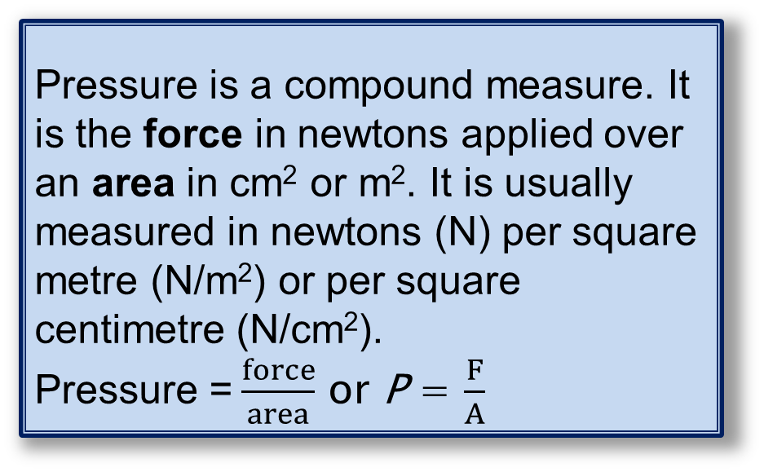
11.3 – More Compound Measures
Page 347
Key Point 5
Pressure is a compound measure. It is the force in newtons applied over an area in cm² or m². It is usually measured in newtons (N) per square metre (N/m²) or per square centimetre (N/cm²).
Pressure =$\frac{force}{area}$ or P = $\frac{F}{A}$
STEM A force of 45 N is applied to an area of 26 000 cm². Work out the pressure in N/m².
Q12 hint - First convert the area to m²

Slide 48
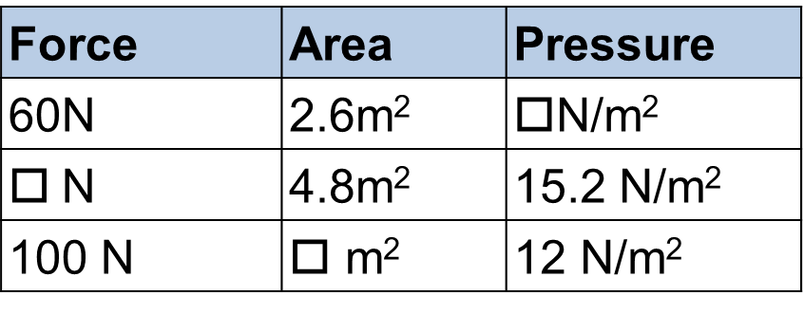
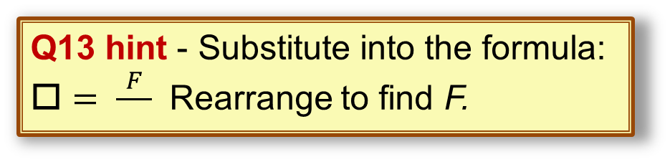
11.3 – More Compound Measures
Page 347
STEM A force applied to an area of 4.5 m² produces a pressure of 20 N/m². Work out the force in N.
STEM Copy and complete the table Give your answers to 3 significant figures.
Q13 hint - Substitute into the formula:
$□= \frac{F}{◻}$ Rearrange to find F.
Force | Area | Pressure
60N | 2.6m² | $□$N/m²
N | 4.8m² | 15.2 N/m²
100 N | $□$ m² | 12 N/m²

Slide 49
11.3 – More Compound Measures
Page 347
STEM A cylindrical bottle of water has a flat, circular base with a diameter of 0.1 m. The bottle is on a table and exerts a force of 12 N on the table.
Work out the pressure in N/cm². Give your answer to 3 significant figures.
The pressure between a car tyre and the road is 99 960 N/m². The car tyres have a combined area of 0.12 m² in contact with the road.
What is the force exerted by the car on the road? Give your answer to 3 significant figures.

Slide 50
11.3 – More Compound Measures
Page 348
Reasoning Jamie sits on a chair with four identical legs.
Each chair leg has a flat square base measuring 2cm by 2cm.
Jamie has a mass of 75 kg and the chair has a mass of 5 kg.
  Use F = mg to work out the combined weight of Jamie and the chair, where g is the acceleration due to gravity.
  Use g= 9.8 m/s².
  Work out the pressure on the floor in N/cm² when only the four chair legs are in contact with the floor.
  The area of Jamie's trainers is 0.04 m². Work out the pressure on the floor when Jamie is standing up. Give your answer in N/m².
  Does Jamie exert a greater pressure on the floor when he is standing up or sitting on the chair?
a. Convert 50 N/cm² to N/m². b. Convert x N/m² to N/cm².
Q17 communication hint - Weight is a force on an object due to gravity and is measured in newtons.

Slide 51
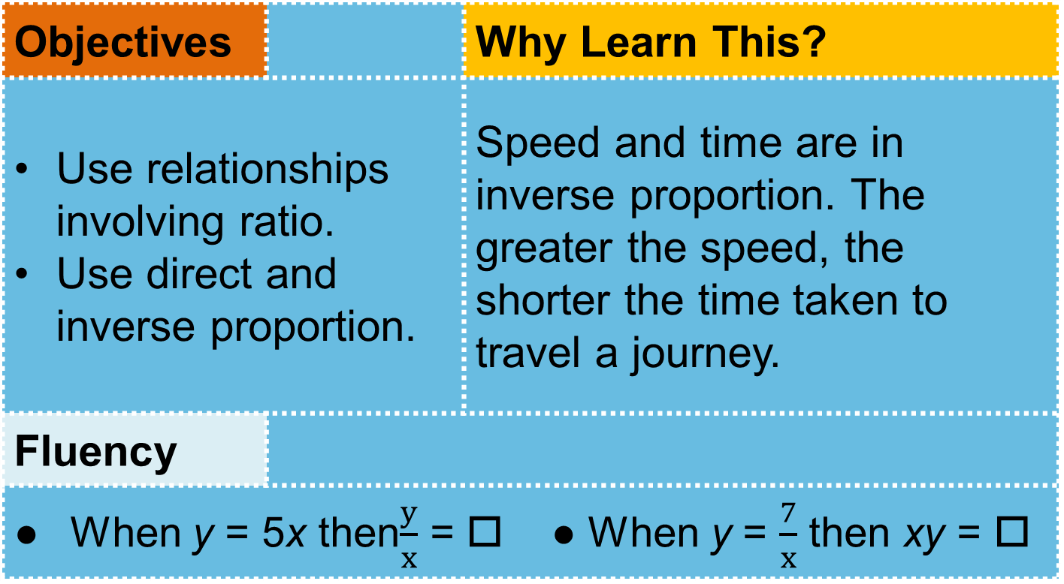
11.3 – More Compound Measures
Page 348
Objectives |  | Why Learn This?
Use relationships involving ratio. Use direct and inverse proportion. |  | Speed and time are in inverse proportion. The greater the speed, the shorter the time taken to travel a journey.
Fluency
When y = 5x then$\frac{y}{x}$ = □ ● When y = $\frac{7}{x}$ then xy = □
ActiveLearn - Homework, practice and support: Higher 11.3

Slide 52
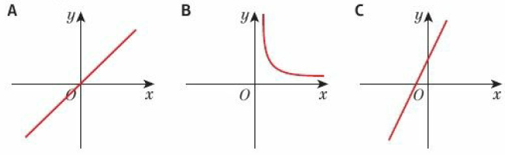

11.4 – Ratio and Proportion
Page 348
Warm Up
Match each graph to an equation.
  y = $\frac{1}{x}$ b. y = x c. y = 2x + 3
What is the gradient of the straight line with equation
  y = 2x + 5 b. y = 3x - 7
  y = 5x d. y = 9x

Slide 53
11.4 – Ratio and Proportion
Page 348
Warm Up
a. Which of these tables show direct proportion between x and y? Explain your answer.
  Plot a line graph for the values in the tables which show direct proportion,
  What do you notice about these graphs?
  Work out the equations of the graphs.
A | x | 2 | 4 | 6 | 8 | B | x | 1 | 2 | 3 | 4
 | y | 8 | 16 | 24 | 32 |  | y | 1 | 4 | 9 | 16
C | x | 0 | 5 | 10 | 15 | D | x | 2 | 4 | 6 | 8
 | y | 2 | 17 | 32 | 47 |  | y | 10 | 20 | 30 | 40

Slide 54
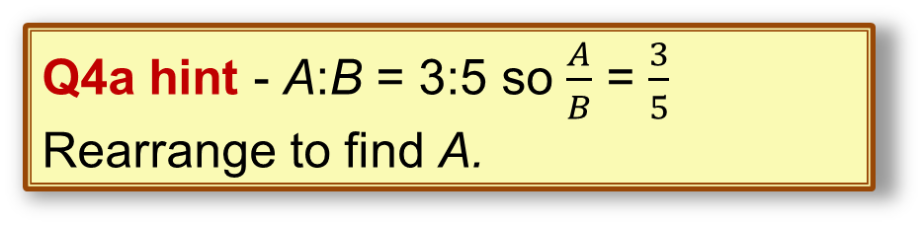
11.4 – Ratio and Proportion
Page 349
Copy and complete these.
  A:B = 3:5 so A = $\frac{□}{□}$B
  P:Q = 7:4 so P = $\frac{□}{□}$Q
  5X = 9Y so X:Y = $□$: $□$
Reflect You have drawn graphs and calculated ratios to check that ratios are in direct proportion. Which method did you like best? Why?
Q4a hint - A:B = 3:5 so $\frac{A}{B}$ = $\frac{3}{5}$
Rearrange to find A.
Q4a hint – Divide both sides by 4.

Slide 55
11.4 – Ratio and Proportion
Page 349
Modelling The table shows some lengths in both miles and kilometres.
  What is the ratio miles: kilometres in the form 1 :n?
  Plot a line graph for these values.
  Are miles and kilometres in direct proportion? Explain your answer,
  What is the gradient of the line?
  Write a formula that shows the relationship between miles and kilometres. Discussion What is the connection between your answers to parts a and d?
  How can you use them to write to formula in part e?
Miles | 5 | 10 | 15 | 20
Km | 8 | 16 | 24 | 32
Q5b hint - Plot miles on the horizontal axis and kilometres on the vertical axis.

Slide 56
11.4 – Ratio and Proportion
Page 349
Modelling The table shows the distance (s) in miles travelled by a car over a period of time (t) minutes.
  Is s in direct proportion to t? Explain,
  What is the relationship between distance (s) and time (t).
  Work out the distance travelled after 25 minutes.
  Discussion Did everyone use the same method?
Distance (s) (miles) | 8 | 16 | 24 | 32 | 40
Time, t, (minutes) | 10 | 20 | 30 | 40 | 50

Slide 57
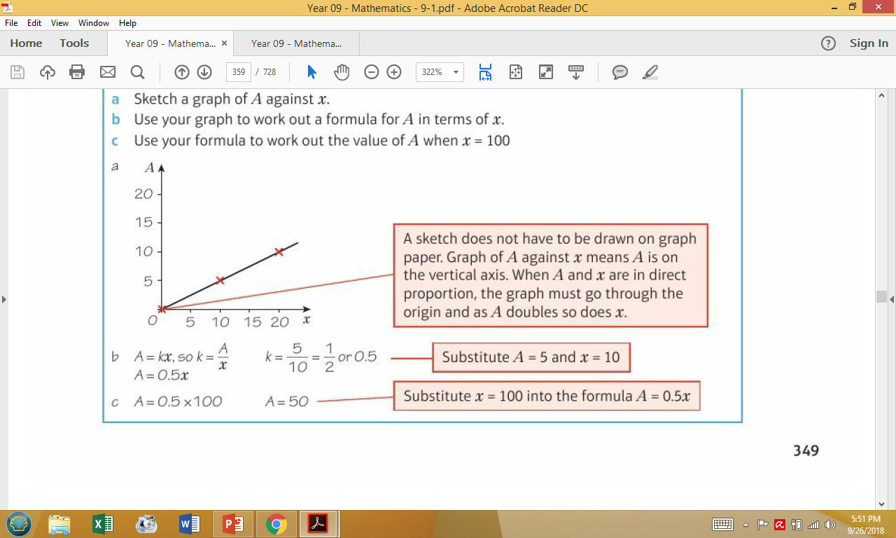
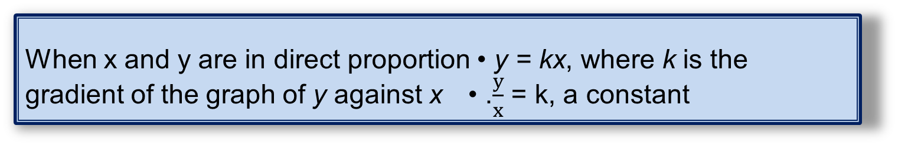

11.4 – Ratio and Proportion
Page 344
Key Point 6
When x and y are in direct proportion • y = kx, where k is the gradient of the graph of y against x • .$\frac{y}{x}$ = k, a constant
Example 4
A is directly proportional to x. A = 5 when x = 10.
Sketch a graph of A against x.
Use your graph to work out a formula for A in terms of x/
Use your formula to work out the value of A when x = 100
b. A = kx, so k = $\frac{A}{x}$
k = $\frac{5}{10}$ = $\frac{1}{2}$ - or 0.5
A = 0.5x
c. A = 0.5 x 100
A = 50

Slide 58
11.4 – Ratio and Proportion
Page 350
The cost of buying 20 litres of petrol is £26.
  Show that the cost, £C, of buying the fuel is directly proportional to the amount, x litres, of fuel bought,
  What is the relationship between C and x?
  Work out the cost of 55 litres of fuel.
Real It takes 3 typists 5 hours to type a report. How long would it take 7 typists? Give your answer to the nearest minute.
Q8 hint – Draw a
table. Plot a graph
of C against x
x | 0 | 5 | 10 | 20
C |  |  |  | 26

Slide 59
11.4 – Ratio and Proportion
Page 350
Key Point 7
When x and y are in inverse proportion, y is proportional to As one doubles (x2) the other halves (÷2).
It takes 5 men 8 hours to build a wall. How long will it take
  6 men b. 3 men?
  For both parts a and b, multiply the exact answer in hours (H) by the number of men (N). What do you notice?
Q10c hint – Write your answer for the time taken in hours in fraction form
Number of hours (H) = $\frac{□}{□}$
H x N = $\frac{□}{□}$ x $□$ = $□$

Slide 60
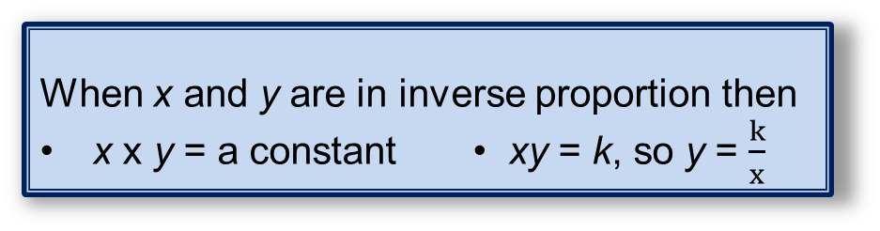
11.4 – Ratio and Proportion
Page 350
Key Point 8
When x and y are in inverse proportion then
x x y = a constant • xy = k, so y = $\frac{k}{x}$
A and B are in inverse proportion. Work out the values of W, X, Y and Z.
r is inversely proportional to t.
r = 15 when t = 0.3
  Find a formula for r in terms of t.
  Calculate the value of r when t = 4
A | 10 | 20 | 14 | Y | Z
B | 14 | W | X | 70 | 28

Slide 61
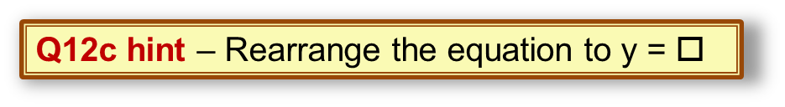
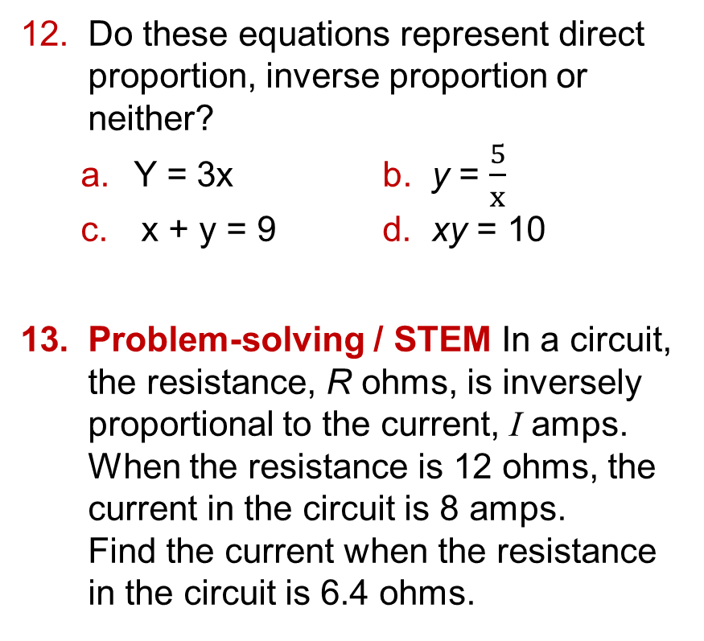
11.4 – Ratio and Proportion
Page 350
Do these equations represent direct proportion, inverse proportion or neither?
  Y = 3x b. y = $\frac{5}{x}$
  x + y = 9 d. xy = 10
Problem-solving / STEM In a circuit, the resistance, R ohms, is inversely proportional to the current, I amps.
When the resistance is 12 ohms, the current in the circuit is 8 amps.
Find the current when the resistance in the circuit is 6.4 ohms.
Q12c hint – Rearrange the equation to y = $□$
Q13 hint – R is proportional to y so R x I = constant

Slide 62
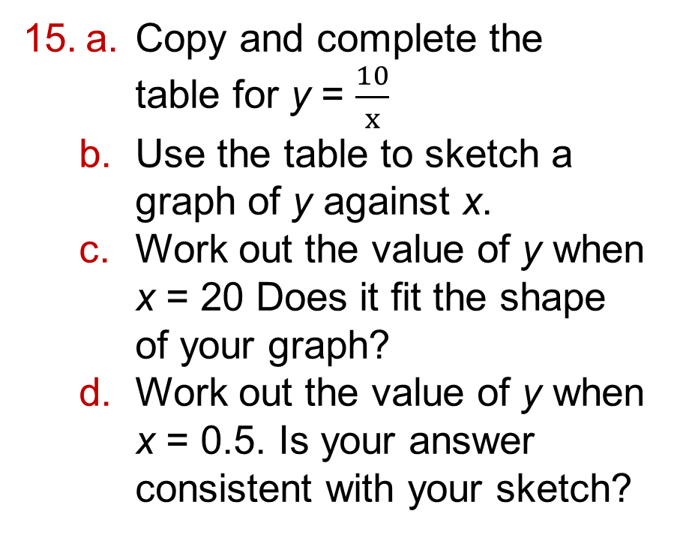
11.4 – Ratio and Proportion
Page 351
a. Copy and complete the table for y = $\frac{10}{x}$
  Use the table to sketch a graph of y against x.
  Work out the value of y when x = 20 Does it fit the shape of your graph?
  Work out the value of y when x = 0.5. Is your answer consistent with your sketch?
x | 1 | 2 | 3 | 4
y

Slide 63
11.4 – Ratio and Proportion
Page 351
16 – Exam-Style Questions
The time, T seconds, it takes a water heater to boil some water is directly proportional to the mass of water, m kg, in the water heater.
When m = 250, T = 600
Find T when m = 400 (3 marks)
The time, T seconds, it takes a water heater to boil a constant mass of water is inversely proportional to the power, P watts, of the water heater. When
P = 1400, T = 360
Find the value of T when P = 900
(3 marks)
June 2006, Q16, 5525/05

Slide 64
11 – Problem Solving
Page 351
Objectives | Use arrow diagrams to solve problems.
Example 5
In 2012, visitor numbers to an ice rink increased by 20% compared to the previous year. In 2013, visitor numbers decreased by 10% compared to the previous year.
In 2013, there were 21762 visitors. How many
visitors were there during 2011?
Number of visitors in 2011 = 21 762 ÷ 0.9 ÷ 1.2
= 20150 ‘ Check: 20150 x 1.2 x 0.9 = 21 762
Use ? to show that you don't know the number of visitors during 2011.
In 2012, visitor numbers increased by 20%. Draw an arrow and a multiplier of 1.2
Year
2011
2012
2013
Number of visitors
?
x 1.2 ÷ 1.2
x 0.9 ÷ 0.9
21762
Draw arrows to work backwards, using the inverse operations:
÷ 0.9, then ÷ 1.2
In 2013, visitor numbers decreased by 10%. Draw an arrow and a multiplier of 0.9
Use the arrow diagram to calculate the number of visitors in 2011.
Check your answer

Slide 65

11 – Problem Solving
Page 351
Judith bought some shares. In the first year they went up in value by 9%. In the second year, they went down in value by 5%. In the third year, they went down in value again by 2.5%. At the end of the third year Judith sold the shares for £2423.07. Did Judith profit or lose on the shares? By how much?
Q1 hint - Judith bought
the shares for
At the end of the first year Continue the arrow diagram. Make sure you answer the question
?
x $□$

Slide 66
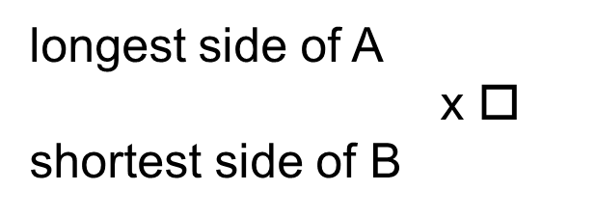
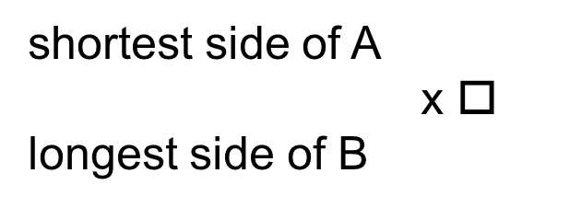
11 – Problem Solving
Page 352
The sides of quadrilateral A are 3cm, 4cm, 6cm and 8cm.
A similar quadrilateral B has shortest side 22.5cm. Find
the length of the longest side of the similar quadrilateral B.
Q2 hint - There is no correct arrow diagram, and you may use different arrow diagrams for different parts of a question.
shortest side of A
x $□$
longest side of B
longest side of A
x $□$
shortest side of B

Slide 67
11 – Problem Solving
Page 352
The sides of quadrilateral A are 3cm, 4cm, 6cm and 8cm.
A similar quadrilateral B has shortest side 22.5cm. Find
the length of the longest side of the similar quadrilateral B.
Q2 hint - There is no correct arrow diagram, and you may use different arrow diagrams for different parts of a question.
shortest side of A
x $□$
longest side of B
longest side of A
x $□$
shortest side of B

Slide 68


11 – Problem Solving
Page 352
How many inches per second is 30 miles per hour?
Q3 hint - Here are arrow diagrams that may help you:
Distance Time
miles
x $5280$
Feet
x 12
inches
hours
÷ $□$
Minutes
÷ $□$
seconds

Slide 69
11 – Problem Solving
Page 352
Real / STEM Concorde flew at an average of 440 metres per second. The distance between London and New York is 5600 km. What was the flight time on Concorde in hours and minutes?
STEM Vinegar is made of acetic acid and water. A factory fills 200 bottles per minute. Each bottle holds 475ml of vinegar. There is 4g of acetic acid per 100ml of water.
How much acetic acid does the factory use in 24 hours? Give your answer in tonnes.

Slide 70
11 – Problem Solving
Page 352
Real / Finance One day in May 2006, the price of copper hit a high at £4463 per tonne. A 2p coin weighs 7.12g. Those made before 1992 are 97 per cent copper.
How much was a 2p coin, made before 1992, worth in copper on that day in May 2006? Give your answer to the nearest penny.
Reflect How did the arrow diagrams help you? Is this a strategy you would use again to solve problems?

Slide 71
11 – Problem Solving
Page 352
11. Check up | Log how you did on your Student Progression Chart
Percentages
Finance Danny bought a car for £10000
The value of the car depreciated by 20% in the first year.
Its value depreciated by another 10% in the second year.
Work out the value of Danny's car at the end of two years.
Finance £3500 is invested for 3 years at 3.4% compound interest.
Work out the total amount in the account after 3 years.

Slide 72
11 – Problem Solving
Page 352
Percentages
Real The number of bees in a hive decreases by 3% each year. There are 7500 bees in the hive at the beginning of 2014. How many bees will there be in the hive at the end of 2020?
Reasoning / Finance Gavin invests £4500 at a compound interest rate of 4.2% per annum. How many years before the investment has grown to £5527.78?
ActiveLearn - Homework, practice and support: Higher 11 Checkup

Slide 73
11 – Problem Solving
Page 352
Compound measures
Reasoning / Finance Scott works a basic 30-hour week. He is paid £8.10 an hour for this work. He is paid time and a quarter for each hour he works on a Saturday and time and a half for each hour he works on a Sunday.
  Scott works a basic 30-hour week, plus 5 hours on Saturday and 4 hours on Sunday.
  How much is Scott paid for the week?
  In one week Scott works a basic 30-hour week and some hours on Saturday.
  He is paid £303.75 for the week. How many hours did Scott work on Saturday?

Slide 74
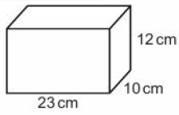
11 – Problem Solving
Page 353
6 – Exam-Style Questions
There are 40 litres of water in a barrel. The water flows out of the barrel at a rate of 125 milliliters per second.
1 litre = 1000 milliliters
Work out the time it takes for the barrel to empty completely. (3 marks)
May 2009, QIO, 1380/3HJ
Reasoning The mass of this plastic cuboid is 2208 g.
Work out the
density of the
plastic in grams
per cm³.

Slide 75
11 – Problem Solving
Page 353
Real A solid cube of steel has sides of length 5 cm.
The density of steel is 8.05 g/cm³.
  Convert 8.05 g/cm3 to kg/m3.
  Work out the mass of the cube.
Real A force of 30N is applied to an area of 3.2 m². Work out the pressure in N/m².
Communication / Real The greatest recorded speed of Usain Bolt is 12.3 m/s.
The greatest speed of a great white shark is 40 km/h. Which is faster? Explain your answer.

Slide 76
11 – Problem Solving
Page 353
Ratio and proportion
Modelling The table shows a comparison of costs in British pounds (P) and euros (E).
  Are British pounds and euros in direct proportion? Explain,
  What is the relationship between British pounds (P) and euros (E)?
  Convert £25 to euros.
Cost in British pounds (P) | 1 | 2 | 5 | 10 | 15
Cost in euros (E) | 1.3 | 2.6 | 6.5 | 40 | 46.5

Slide 77
11 – Problem Solving
Page 353
Communication / Problem-solving The pressure, P, of water on an object (in bars) is directly proportional to its depth, d (in metres). When the object is at a depth of 8 metres the pressure on the object is 0.8 bars.
A diver's watch has been guaranteed to work at a pressure up to 8.5 bars. A diver takes the watch down to 75 m. Will the watch still work? Give a reason for your answer.
Problem-solving / Real In a circuit, the resistance, R ohms, is inversely proportional to the current, 1 amps. When the resistance is 14 ohms, the current in the circuit is 9 amps. Find the current when the resistance is 12 ohms.

Slide 78
11 – Problem Solving
Page 353
Reflect
How sure are you of your answers? Were you mostly:
Just guessing ☹ Feeling doubtful 😐 Confident ☺
What next? Use your results to decide whether to
strengthen or extend your learning.
* Challenge
The times, distances and speeds of athletes in a 5 km race and a 10 km race have got mixed up. Sort them into the 5 km and 10km races and then compile a leader board for each race.
  Allia: 18 minutes 38 seconds, 5 km
  Billie: 1364 seconds, 13.2 km/h
  Chaya: 20 minutes 50 seconds, 4m/s
  Daisy: 10 km, 4.1 m/s
  Ellie: 10 km, 13 km/h
  Fion: 2105 seconds, 17.1 km/h
  Gracie: 45 minutes 3 seconds, 3.7 m/s
  Hafsa: 5 km, 3.9 m/s
Q15 strategy hint - Use the formula connecting distance, speed and time to work out the missing times and distances for each person.

Slide 79
11 – Strengthen
Page 354
11. Strengthen
Percentages
Write down the multipliers for these percentage increases as a decimal number,
  20% b. 9% c. 3.7%
Write down the multipliers for these percentage decreases as a decimal number,
  a 23% b. 6% c. 7.5%
Q1a hint - Original = 100%. After increase = 100% + □% = □ % Write % as a decimal
Q2a hint - Original = 100%. After decrease = 100% - □% = □ % Write % as a decimal

Slide 80
11 – Strengthen
Page 354
Write down the multiplier for
  an increase of 20% followed by an increase of 9%
  an increase of 10% followed by an increase of 15%
  a decrease of 23% followed by a decrease of 6%
  a decrease of 11% followed by a decrease of 9%
  an increase of 12% followed by a decrease of 8%.
Q3a hint - Use your answers to Q1a and b. Multiplier for increase of 20% followed by increase of 9% = □ x □ = □

Slide 81
11 – Strengthen
Page 354
Finance Penny buys a new TV for £750. In the first year the value depreciates by 15%. In the second year the value depreciates by 5%. Work out the value of Penny’s TV after 2 years.
Finance / Problem-solving A company
bought a van for £15000. Each year the
value of the van depreciated by 20%.
Work out the value of the van at the end
of four years.
Q4 hint - Write down the multipliers for 15% and 5%.
Q6 hint –
Draw a
table:
Year | Value of van (£)
0 | 1500
1 | □

Slide 82
11 – Strengthen
Page 354
Finance Harry invests £400 at 3% compound interest. Copy and complete the table.
Year | Amount at start of year | Amount plus interest | Total amount at end of year
1 | £400 | 400 x 1.03 | £412
2 | £412 | 412 x 1.03 = 400 x 1.03² | £424.36
3 | £424.36 | 424.36 x 1.03 = 400 x 1.03³ | £437.09
4 | £437.09 | 437.09412x 1.03 =
5
6

Slide 83
11 – Strengthen
Page 354
Problem-solving A population of ants increases at a rate of 30% per day. At the end of one week there are 3500 insects.
How many insects were there at the beginning of the week?
Q7 hint –
Draw a
table:
Day | Number of ants
6 | ÷ □
7 | 3500

Slide 84
11 – Strengthen
Page 354
Problem-solving Molly invests £2000 at a compound interest rate or 2.3% per annum.
After how many years will she have more than £2200?
Q8 hint –
Draw a
table:
Day | Amount (£)
0 | 2000
1 | ÷ □

Slide 85
11 – Strengthen
Page 355
Compound measures
Reasoning / Finance Ellie works a basic 35-hour week. Her hourly rate of pay is £6.80.
She is paid time and a quarter for each hour she works on a Saturday and time and a half for each hour she works on a Sunday.
How much is Ellie paid for a week when she works a basic 35-hour week, plus 4 hours on Saturday and 3 hours on Sunday?
Q1 hint – Basic pay = £6.80
Pay at time and a quarter = £6.80 x 1.25 = □
Pay at time and a half = £6.80 x □ = □
Total pay = 35 x £6.80 + 4 x □ +3 = □

Slide 86
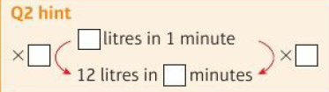
11 – Strengthen
Page 355
Reasoning A bucket holds 12 litres of water. Water flows out at a rate of 50 ml per second. Work out
  The amount of water flowing out per minute. Give your answer in litres,
  The time it will take the bucket to empty.

Slide 87
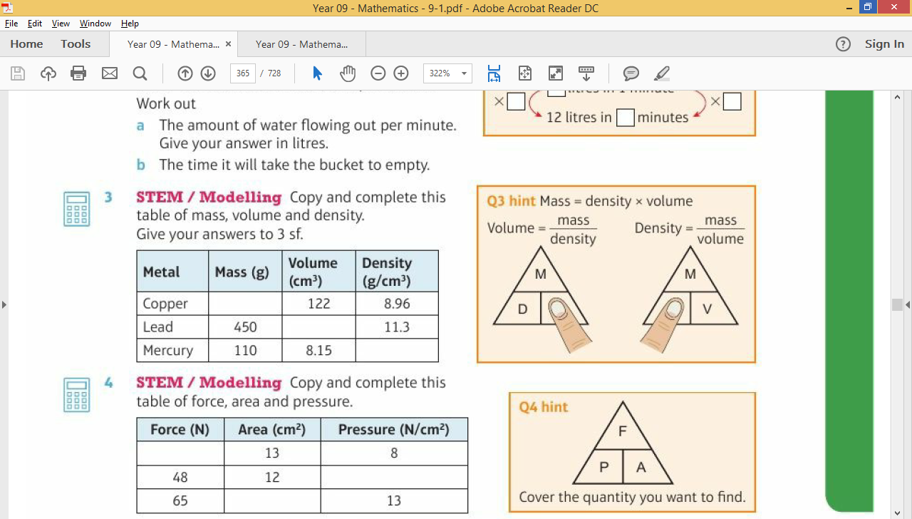
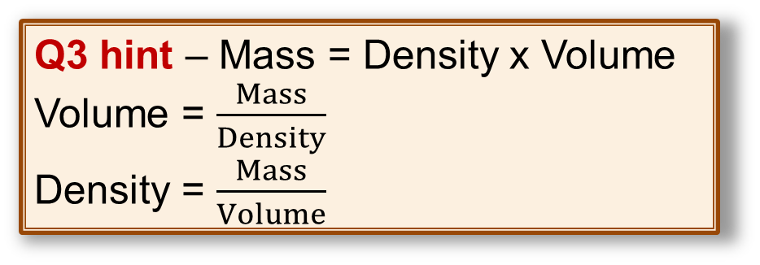
11 – Strengthen
Page 355
STEM / Modelling Copy and complete this table of mass, volume and density.
Give your answers to 3 sf.
Metal | Mass (g) | Volume (cm³) | Density (g/cm³)
Copper |  | 122 | 8.86
Lead | 450 |  | 11.3
Mercury | 110 | 8.15
Q3 hint – Mass = Density x Volume
Volume = $\frac{Mass}{Density}$
Density = $\frac{Mass}{Volume}$

Slide 88
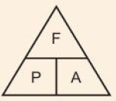
11 – Strengthen
Page 355
STEM / Modelling Copy and complete this table of force, area and pressure.
Force (N) | Area (cm3) | Pressure (N/cm³)
 | 13 | 8
48 | 12
65 | 110 | 13
Q4 hint – Cover the
quality you want to
find.

Slide 89
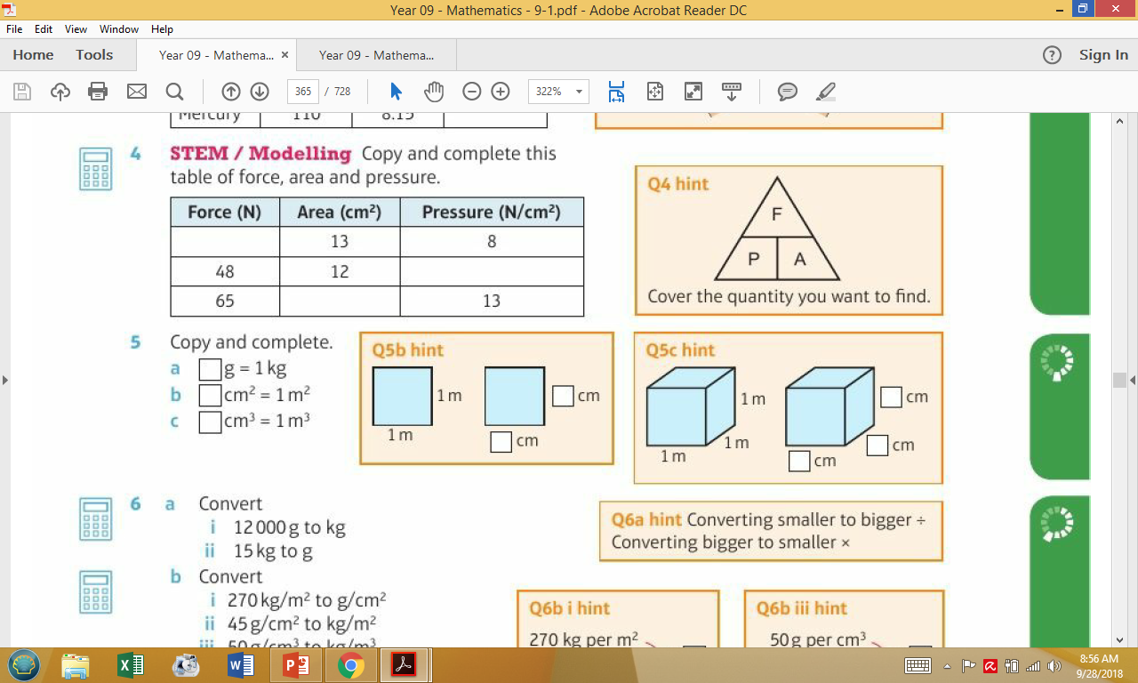
11 – Strengthen
Page 355
Copy and complete.
  □g = 1kg
  □ cm² = 1m²
  □ cm³ = 1m³
Q5b hint –
Q5c hint –

Slide 90
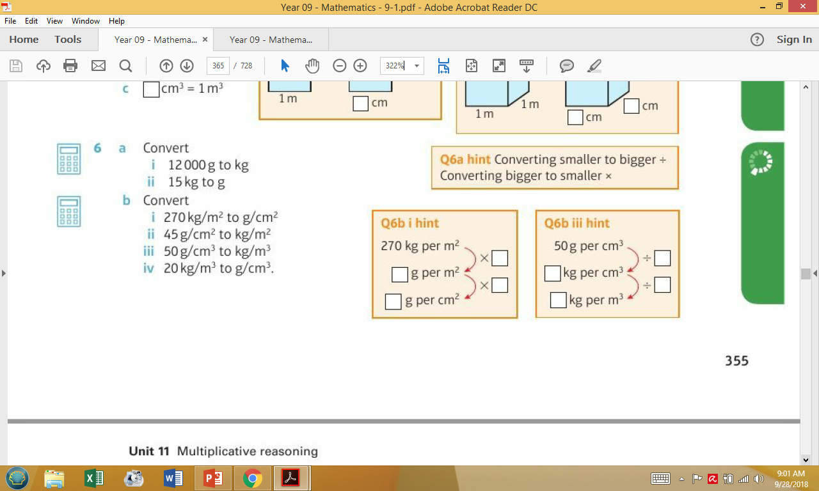
11 – Strengthen
Page 355
a. Convert
    12000g to kg ii. 15 kg to g
  Convert
    270kg/m² to g/cm²
    45g/cm² to kg/m²
    50g/cm³ to kg/m³
    20 kg/m³ to g/cm³.
Q6a hint – Converting smaller to bigger ÷ Converting bigger to smaller x
Q6b i hint
Q6b ii hint

Slide 91
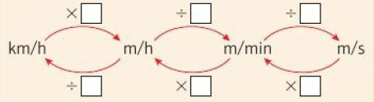
11 – Strengthen
Page 356
Copy and complete this table to convert from km/h to m/s.
Km/h | m/h | m/min | m/s
18
 |  |  | 10
24
 |  |  | 16
Q7 hint –

Slide 92
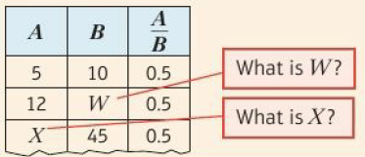

11 – Strengthen
Page 356
Copy and complete this table to convert from km/h to m/s.
Find the
missing
numbers
W, X, Y and Z.
A | B
5 | 10
12 | W
X | 45
15 | Y
Z | 36
Q1 hint – When A and B are in direct proportion, $\frac{A}{B}$ = constant. This means it always has the same value.

Slide 93
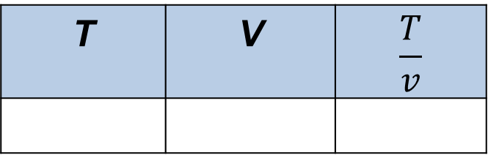
11 – Strengthen
Page 356
The time, T seconds, it takes a kettle to boil some water is directly proportional to the volume of water, vcm³, in the kettle. When v = 300 cm³, T = 120 seconds.
How long will it take to boil 500cm³ of water?
Q2 hint – Draw a table
T | V | $$\frac{T}{v}$$

Slide 94

11 – Strengthen
Page 356
Mike exchanges 100 British pounds (£) for 80 euros (€).
  Show that the number of pounds exchanged, P, is directly proportional to the number of euros received, E, by drawing a graph,
  Find a formula for P in terms of E.
Q3a hint – Set up a table for the number of euros for a given number of pounds.
Put P on the y-axis and E on the x-axis. Does the graph
pass through (0,0)?
Do the points lie on
a straight line?
P | 10 | 25 | 50 | 100
E |  |  |  | 80
Q3ba hint – When P and E are direct proportion, $\frac{P}{E}$ = constant. Rearrange $\frac{P}{E}$ = □ to get P = □

Slide 95
11 – Strengthen
Page 356
For a constant force, pressure, P (in N/m²) is inversely proportional to the area, A (in m²) it acts on.
When the area is 2m², the pressure is 16N/m². Work out the pressure when the area is 0.5 m².
Q4 hint –
Draw a table
P | A | PA
16

Slide 96

11 – Strengthen
Page 356
A and B are in inverse proportion. Work out the values of W, X, Y and Z.
A | B
6 | 8
8 | W
X | 16
12 | Y
Z | 12
Q5 hint – When A and B are in inverse proportion, A x B = constant
8W = 48
W = 48 ÷ □ = □
16X = 48

Slide 97
11 – Extend
Page 357
11. Extend
Real In a spring, the tension (T newtons) is directly proportional to its extension (x cm). When the tension is 150 newtons, the extension is 6 cm.
  Write a formula for T in terms of x.
  Calculate the tension, in newtons, when the extension is 15 cm.
  Calculate the extension, in cm, when the tension is 600 newtons.

Slide 98

11 – Extend
Page 357
STEM / Problem-solving The diagram shows a piece of plastic cut into the shape of a trapezium. A force is exerted evenly over the trapezium.
Work out the force required to create a pressure of 20 N/cm² on the trapezium.

Slide 99
11 – Extend
Page 357
Use the kinematics formulae in these questions,
  A train starts from rest and accelerates at 3 m/s² for 15 seconds. What is its final velocity in km/h?
  Rafael hits a tennis ball at 20 m/s. It hits the net, 8 m away, at a speed of 12 m/s.
  What was its deceleration in m/s²?
  A ball dropped from the top of a 120 m tower takes 4.9 seconds to reach the ground. Calculate its acceleration,
  A car starts from rest and accelerates to v m/s in 20 seconds. Find the acceleration in terms of v.
Q3 hint - Kinematics formulae:
v = u + at
s = ut + ½at²
v² = u² + 2 as
Q5 communication hint - Deceleration is negative acceleration.

Slide 100
11 – Extend
Page 357
Finance / Reasoning George invests £4500 at a compound interest rate of 5% per annum. At the end of n complete years the investment has grown to £5469.78 Find the value of n.
Finance / Reasoning Gwen bought a new car. Each year, the value of her car depreciated by 9%.
  Let £x be the original price of the car. Write an expression for the value of the car after 1 year,
  After how many years was the car worth less than half of its original price?
Q5b hint - When is the value < 0.5x?

Slide 101
11 – Extend
Page 357
Finance The value of a car depreciates by 25% each year. At the end of 2015 the value of the car was £2560.
Work out the value of the car at the end of 2010.
Problem-solving Your manager says you can either have a 2.5% pay rise this year and then a 1.5% pay rise next year, or a 3.5% pay rise this year and no pay rise next year. Which would you prefer?
Q7 strategy hint - Decide on a salary figure to work with.

Slide 102

11 – Extend
Page 357
Problem-solving Plastic block A has a mass of 1.2 kg. Plastic cube B is made from plastic with a density 40% greater than the plastic block.
Work out the mass of the plastic cube. Give your answer in grams to three significant figures.

Slide 103
11 – Extend
Page 358
Finance Chloe invests £3000 at 3.2% per annum compound interest,
  Copy and complete this table of values.
  Plot the graph of y against n. Join the points,
  Estimate when Chloe will have £3350 in her account.
Problem-solving The number of outlets of a coffee shop chain in the UK increases at rate of 9% for 10 years. At the end of the 10 years there are 350 coffee shops.
How many were there at the beginning of the 10 years?
Number of years, n | 0 | 1 | 2 | 3 | 4
Value, y | 3000
Q9 hint – Round to the nearest £10

Slide 104

11 – Extend
Page 358
Problem-solving Carrie buys a motorbike. The value
of the motorbike depreciates by 10% each year. Write down the letter of the graph which best shows how the value of Carrie's motorbike changes with time.

Slide 105
11 – Extend
Page 358
Reasoning The size of an exterior angle of a regular polygon is inversely proportional to the number of sides of the polygon.
  Sam thinks this means that if one polygon has twice the number of sides of another polygon the size of the exterior angle is half the size of the original exterior angle.
  Is Sam correct? Explain.
  The size of an exterior angle of a regular hexagon is 60°.
  What is the size of the exterior angle of a 20-sided polygon?

Slide 106

11 – Extend
Page 358
13 – Exam-Style Questions
Sumeet has a pond in the shape
of a prism. The pond is completely full of
water.
Sumeet wants to empty the
pond so he can clean it.Sumeet
uses a pump to empty the pond.
The volume of water in the pond
decreases at a constant rate. The level of the water in the pond goes down by 20 cm in the first 30 minutes.
Work out how much more time Sumeet has to wait for the pump to empty the pond completely. (6 marks)
June 2013, Q17, 1MA0/IH
Q13 strategy hint – First find the volume of the pond, and then find the rate of which the volume of water is emptied in m³ per hour.

Slide 107

11 – Knowledge Check
Page 359
11 – Knowledge Check
In compound interest the interest earned each year is added to money in the account and earns interest the next year. Most interest rates are compound interest rates. Total interest = amount in the account at the end of the investment - amount invested. You can calculate an amount after n years’ compound interest using the formula amount = initial amount x ($\frac{100 +interest}{\text{100}}$) Compound measures such as speed, density and pressure combine measures of two different quantities. Speed can be measured in metres per second (m/s), kilometres per hour (km/h) or miles per hour (mph). Average speed = $\frac{distance}{\text{time}}$ or S = $\frac{D}{\text{T}}$
Mastery
Lesson 11.1
Mastery
Lesson 11.1
Mastery
Lesson 11.1
Mastery
Lesson 11.2 and 11.3
Mastery
Lesson 11.2

Slide 108

11 – Knowledge Check
Page 359
11 – Knowledge Check
These are three kinematics formulae: v = u + at s = ut + ½at² v² = u² + 2 as where a is constant acceleration, u, is initial velocity, v is final velocity. S is displacement from the position when t = 0 and t is time taken. Velocity is speed in a given direction, possible units are m/s. Initial velocity is speed in a given direction at the start of the motion. Acceleration is the rate of change of velocity, i.e. a measure of how the velocity changes with time, possible units are m/s². Density is the mass of substance in g contained in a certain volume in cm³ and is often measured in grams per cubic centimetre (g/cm³). Density = $\frac{mass}{\text{volume}}$ or D = $\frac{M}{\text{V}}$
Mastery
Lesson 11.2
Mastery
Lesson 11.2
Mastery
Lesson 11.2
Mastery
Lesson 11.2

Slide 109

11 – Knowledge Check
Page 359
11 – Knowledge Check
Pressure is the force in newtons applied over an area, in cm² or m². It is usually measured in newtons (N) per square metre (N/m2) or per square centimetre (N/cm²). Pressure = $\frac{forse}{\text{area}}$ or P = $\frac{F}{\text{A}}$ When x and y are in direct proportion y = kx, where k is the gradient of the graph of y against x $\frac{y}{\text{x}}$ = k, a constant. When x and y are in inverse proportion, y is proportional to $\frac{1}{x}$. As one doubles (x2) the other halves (÷2). When x and y are in inverse proportion then x x y = a constant, xy = k, so y = $\frac{k}{x}$-. This unit is called multiplicative reasoning. List three ways you have used multiplication or division in this unit. Why is it good to reason in mathematics?
Mastery
Lesson 11.3
Mastery
Lesson 11.4
Mastery
Lesson 11.4
Mastery
Lesson 11.4
Communication hint - 'Multiplicative' means involving multiplication or division. Reasoning is being able to explain why you have done some maths a certain way.
Reflect

Slide 110
11 – Unit Test
Page 360
11. Unit Test | Log how you did on your Student Progression Chart.
Kinematics formulae
v = ut + at s = ut + ½at² v² = u² + 2as
A car has an initial speed of u m/s.
The car accelerates to a speed of 4u m/s in 20 seconds.
Find the acceleration in terms of u.
(3 marks)
A leopard travels 100 metres in 7.19 seconds. What is its average speed:
  in m/s (2 marks)
  in km/h? (2 marks)
  Give your answer to 3 significant figures.

Slide 111

11 – Unit Test
Page 360
Reasoning A cylindrical glass has a circular base with radius 4cm. The glass exerts a force of 7N on the table. Work out the pressure in N/m² (3 marks)
When travelling at constant speed the distance, D, travelled by a particle is directly proportional to the time taken, t.
When t = 20, D= 45
  Find a formula for D in terms of t
  (3 marks)
  Calculate the value of D when t = 48
  (1 mark)
  Calculate the value of t when D = 12
  Give your answer correct to 3 significant figures. (2 marks)

Slide 112

11 – Unit Test
Page 360
4 – Exam-Style Questions
The diagram
shows a solid
prism made
from metal.
The cross-section of the prism is a trapezium.
The parallel sides of the trapezium are 8 cm and 12 cm.
The height of the trapezium is 6 cm.
The length of the prism is 20 cm.
The density of the metal is 5g/cm³.
Calculate the mass of the prism.
Give your answer in kilograms.
(5 marks)
Nov 2011, Q/6, 1380/3H

Slide 113
11 – Unit Test
Page 361
6 – Exam-Style Questions
A company bought a van that had a value of £12000. Each year the value of the van depreciates by 25%.
  Work out the value of the van at the end of three years. (3 marks)
  The company bought a new truck.
  Each year the value of the truck depreciates by 20%.
  The value of the new truck can be multiplied by a single number to find its value at the end of four years.
  Find this single number as a decimal. (2 marks)
  June 2004, Q12, 5506/06

Slide 114
11 – Unit Test
Page 360
A television loses 4% of its value every month. It was bought for £950 at the beginning of January. How much will it be worth at the end of June?
(3 marks)
When a constant force is applied, the resulting pressure P, is inversely proportional to the area, A. When A = 8, P = 5
  Find a formula for A in terms of A. (3 marks)
  Calculate the value of P when A =2 (1 mark)

Slide 115
11 – Unit Test
Page 360
9 – Exam-Style Questions
Emma invests £4000 in an account for 2 years. The account pays 3.8% compound interest. Emma has to pay 20% tax on the interest earned each year. The tax is taken from the account at the end of each year.
How much will Emma have in the account at the end of 2 years? (4 marks)

Slide 116

11 – Unit Test
Page 360
9 – Exam-Style Questions
Nicola invests £8000 for 3 years at 5% per annum compound interest,
Calculate the value of her investment at the end of the 3 years. (3 marks)
Jim invests a sum of money for 30 years at 4% per annum compound interest.
Write down t he letter of the graph which best shows how the value of Jim’s investment changes over the 30 years. (1 mark)
Hannah invested an amount of money in an account paying 5% per annum compound interest. After 1 year the value of her investment was £3885
Work out the amount of money that Hannah invested. (3 marks)
Nov 2004, Q14. 5504/04

Slide 117
11 – Unit Test
Page 360
Sample student answers
Which student gives the better answer? Explain.
11 – Exam-Style Questions
Student A
2000 x 1.04 x 1.01 = 2100.5 2000 x 1.05 x 1.005 = 2110.5
Student B
International Bank
Year 1 2000 x 1.04 = 2080
Year 2 2080 x 1.01 = £2100.80
Friendly Bank
Year 1 2000 x 1.05 = 2100
2100 x 1.005 = £2110.50 ✓
Viv will get more money if she invests in the Friendly Bank.
Viv wants to invest £2000 for 2 years in the same bank.
At the end of 2 years, Viv wants to have as much money as possible. Which bank should she invest her £2000 in?
(4 marks)
June 2013, Q14, 1MA0/2H
The International Bank
Compound interest
4% for the first year
1 % for each extra year
The Friendly Bank
Compound interest
5% for the first year
0.5 % for each extra year

Slide 118











Warm Up
∪ ∩
Reflect
14 – Exam-Style Questions
∞
$$\frac{4}{7}$$
$$\frac{□}{□}$$
Sophie is making Christmas cards. She needs a card and an envelope for each card.
How many packs of cards and envelopes did she buy? (3 marks)
$\overline{x}$. $\overline{y}$
(${2 \atop 1}$)
≈ є ϵ
∠ π
$$\sqrt{16}$$
±
①
②
③
④
ActiveLearn - Homework, practice and support: Higher 3.1
$$\sqrt[1]{3}$$
4͘͘
1̇
Q3 hint - The symbol ± shows that.
≠ ÷
Key Point 1
4
When there are m ways of doing one task and n
Q5 communication hint - Inclusive means that the end numbers
Q9f strategy hint - The symbol
X
-5 -4 -3 -2 -1 0 1 2 3 4 5
Age (x) | Male | Female
20 ≤ x < 25 | 1 | 0
Exam hint
Show a separate
Number | 1 | 2 | 3 | 4 | 5
Frequency | 46 | 39 | 37 | 40 | 38

